Slide 1
Poverty Reduction and the Developing Brain
Greg J. Duncan

Slide 2
Would reducing poverty help children and their parents?
Timing – does early poverty matter the most?
Income-based poverty may not be the most important factor, but it is the most manipulable with policy

Slide 3
Theories of change
Higher Income
What money can buy
Child/Adult outcomes:
Attainment
Socio-emotional behavior
Maternal mental health and parenting

Slide 4
Causal evidence on income effects
 | When income is received
 | Very early childhood | School transition/ middle childhood | Adoles-cence
Child achieve-ment
Child attainment
Maternal stress

Slide 5
Causal evidence on income effects
 | When income is received
 | Very early childhood | School transition/ middle childhood | Adoles-cence
Child achieve-ment |  | Mostly + | Null
Child attainment |  |  | Mostly +
Maternal stress |  | One study: +

Slide 7
Causal evidence on income effects
 | When income is received
 | Very early childhood | School transition/ middle childhood | Adoles-cence
Child achieve-ment | ? | Mostly + | Null
Child attainment | ? |  | Mostly +
Maternal stress | ? | One study: +

Slide 8
For long-run links between early childhood income and adult outcomes, only longitudinal data are available

Slide 9
Data and Sample
Panel Study of Income Dynamics (PSID)
National sample of children followed from birth into adulthood
Children born between 1968 and 1975
Adult outcomes measured between ages 30 and 39

Slide 10
Associations between income increases and adult outcomes, by childhood stage
Adult outcome (age 30-39) | Age when income is measured
 | Prenatal to age 2 |  | Age 3-5 |  | Age 6-15
Earnings | + |  | ns |  | ns
Work hours | + |  | ns |  | ns
Wage rate | ns |  | ns |  | ns
Shaded boxes indicate coefficient was significant at p<.05. Source: Ziol-Guest et al. (2012)

Slide 11
Associations between income increases and adult outcomes, by childhood stage
Adult outcome (age 30-39) | Age when income is measured
 | Prenatal to age 2 |  | Age 3-5 |  | Age 6-15
Earnings | + |  | ns |  | ns
Work hours | + |  | ns |  | ns
Wage rate | ns |  | ns |  | ns
Work limitations | - |  | ns |  | ns
Arthritis | - |  | ns |  | +
Hypertension | - |  | ns |  | ns
Depression | ns |  | ns |  | ns
General health | ns |  | ns |  | ns
Shaded boxes indicate coefficient was significant at p<.05. Source: Ziol-Guest et al. (2012)

Slide 12
Substantial effect sizes
$4,000 increase in annual income between the prenatal year and age 2:
19% increase in adult earnings
160 hour increase in adult work hours
No significant change in wage rate
Reduction in arthritis from 9% to 6%

Slide 13
But these effects are based on non-experimental data
Most pressing needs:
Random assignment study of income effects
Focused on early childhood
Capitalizing on insights from developmental neuroscience

Slide 14
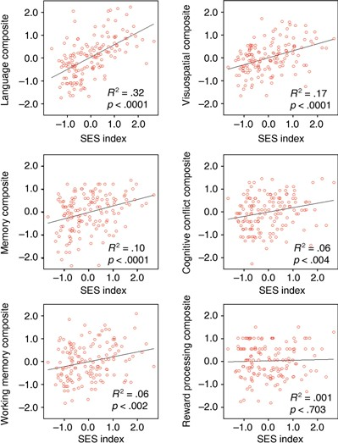
Language
Visuospatial
Memory
Cognitive conflict
Working memory
Reward processing
Noble, McCandliss, Farah (2007)

Slide 15
Poverty Reduction and the Developing Brain
Social/Behavioral Scientists:
Katherine Magnuson (Univ of Wisconsin)
Hiro Yoshikawa (NYU)
Lisa Gennetian (NBER, NYU)
Neuroscientists:
Kimberly Noble (Columbia University)
Nathan Fox (University of Maryland)
Charles Nelson (Harvard University)

Slide 16
RCT
1,000 (total) mothers, all poor, recruited in hospitals
Random assignment into two treatment arms:
i) $4,000/year for each of three years ($333/month)
ii) nominal amount ($20/month)
No restrictions on how the money is spent
Sites (preliminary) :
Columbia University, Minnesota
Tulane, New Orleans; South Carolina
UC Irvine, Orange, CA
Others?? New Zealand, Europe?
Interviews at birth, age 1, 2 and 3…
Notes:
Decent power to detect effects: Family income boost of $3,760 per year (.20 sd – the equivalent of 3 IQ points)

Slide 17
Theory of change
Higher Income
Enrichment
pathway
Child outcomes
Stress pathway

Slide 18
Enrichment pathways model
Immediate impacts
Secondary impacts on parents and family
Child outcomes
Higher Income
Better able to meet basic needs
Higher quality non-parental care
Improved housing & neighborhood
More parental time with child
Higher quality parenting (responsiveness/ warmth)
Greater amount and complexity of linguistic input
More cognitive stimulating interactions
Better Language Development
Less parent stress
Better parental mental health
More stimulating home environment: books, etc
Higher IQ (or pre-academic skills)
More stimulating nonparental care environment

Slide 19
Stress pathways model
Immediate impacts
Secondary impacts on parents and family
Child outcomes
Higher Income
Better able to meet basic needs
Higher quality non-parental care
Improved housing & neighborhood
More parental time with child
Better executive functioning
Higher quality parenting (responsiveness/ warmth)
Less parent stress
Better parental mental health
Less child stress and better HPA functioning
Better socio-emotional processing
Less chaos, more stability
More stable & more responsive nonparental care
Better physical health

Slide 20
Data collection
The early brain at age 3:
EEG measures of brain activity at university labs
Child developmental and health outcomes at age 3:
Language, declarative memory, self-regulation, IQ, BMI, stress, overall physical and mental health
Family and mediating processes in years 1, 2 and 3:
Employment, material hardship and child care calendar year 1
Changes in employment and child care experiences years 2 and 3
Maternal psychological health, family composition, parenting, material hardship at years 2 and 3

Slide 21
Pilot study to begin in a month:
Recruit 30 mothers at birth at Columbia
Follow for a year
Employ all planned study procedures
Qualitative study of family process and reactions to the payments

Slide 22
Robin Hood Foundation may fund:
A fully-powered $8,000 treatment arm
A site for the $4,000 multi-site national study
All in NYC

Slide 23
Greg J. Duncan
gduncan@uci.edu

